Slide 1
Blackboard Essentials
FWISD
Division of Communication

Slide 2
Logging In
Navigate to www.fwisd.org
At the the bottom of the homepage, click “Sign In” on the left
You will be prompted to enter your username/password. Use your active directory to log in. Make sure you do not add “@fwisd.org” when entering your user name, it will just be your first and last names.
If it is your first time logging in, contact Thomas Ketchersid to grant you editing rights after steps 1, 2 and 3. *Screenshots on next slide

Slide 3
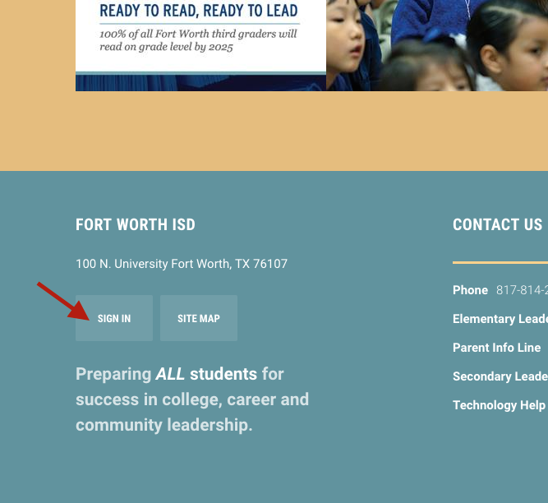
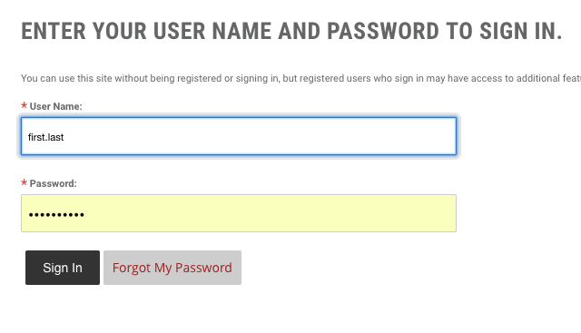

Slide 4
Site Manager
STREAMS
PASSKEYS
*SITE MANAGER*
Now that you have successfully logged in, you will see a thin, black menu bar on the left-hand side. At the top should be your initials followed by three other icons
“Streams” allows you to select which sites you wish to follow
“Passkeys” are not important
“Site Manager” is how you access the editing side of your site. Click it!

Slide 5
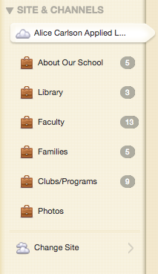
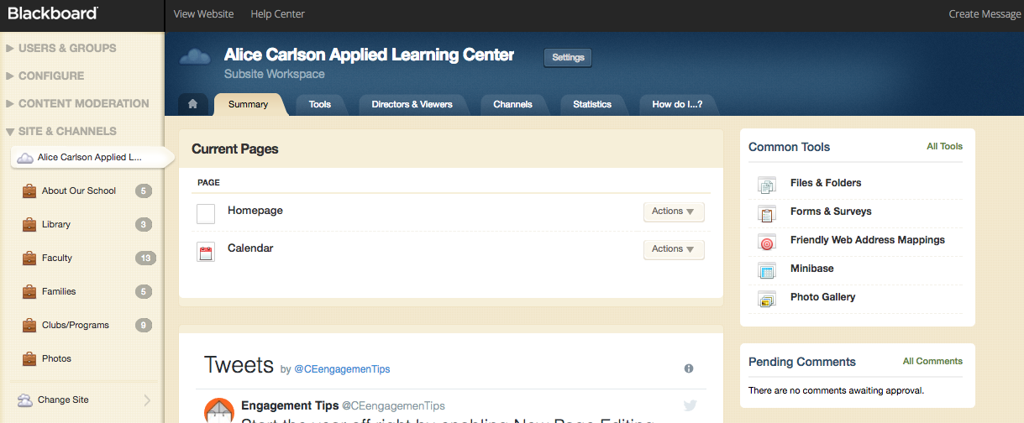
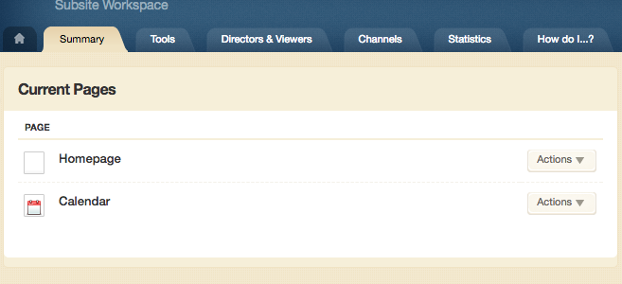
Site Manager
In Site Manager there are two areas to be familiar with: Current Pages and Sites & Channels

Slide 6
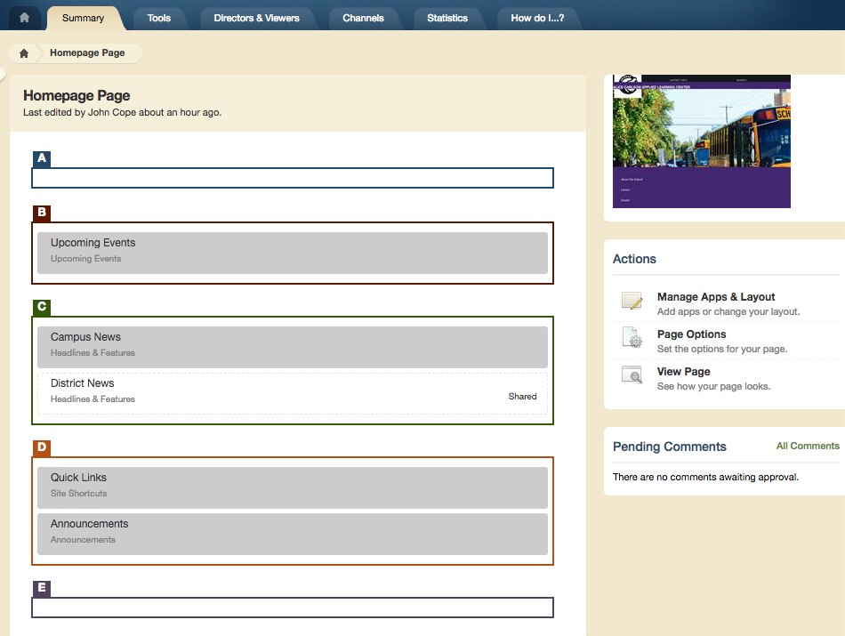
Current Pages
Homepage
The homepage of your website is organized by a series of “Apps” in the backend that push content to the homepage
Whenever you want to add a date to the calendar, publish a news item, create an announc- ement or a link, you go to “Homepage” in Site Editor to manage the corresponding app

Slide 7
Current Pages
Homepage
Manage Apps & Layout
Click this first to access the app
Apps
Then click the app you want to access
“District News” and “Upcoming Events” can not be accessed here
Upcoming Events feeds from your calendar

Slide 8
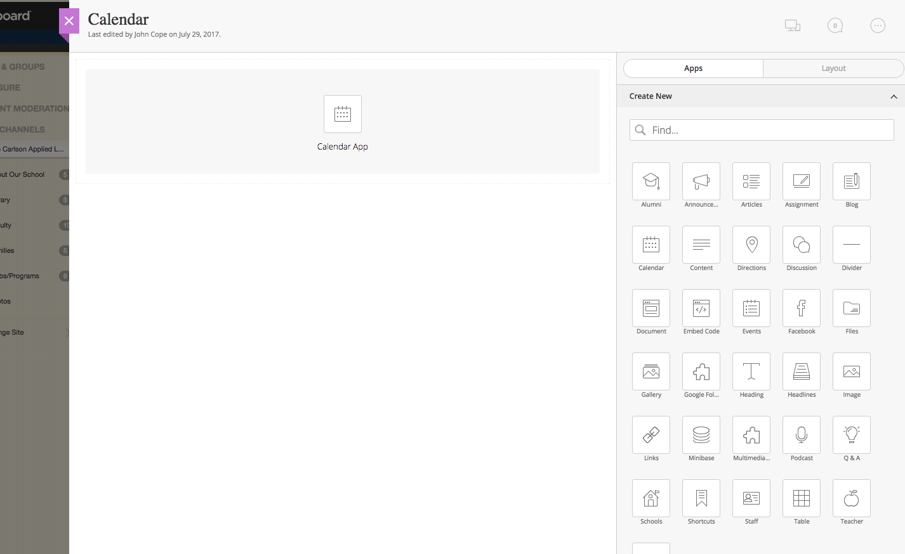
Current Pages
Calendar
Whenever you click “Calendar” under Current Pages you will be directed to the calendar section.
To add and edit events click the “Calendar App” In the center of the page.

Slide 9
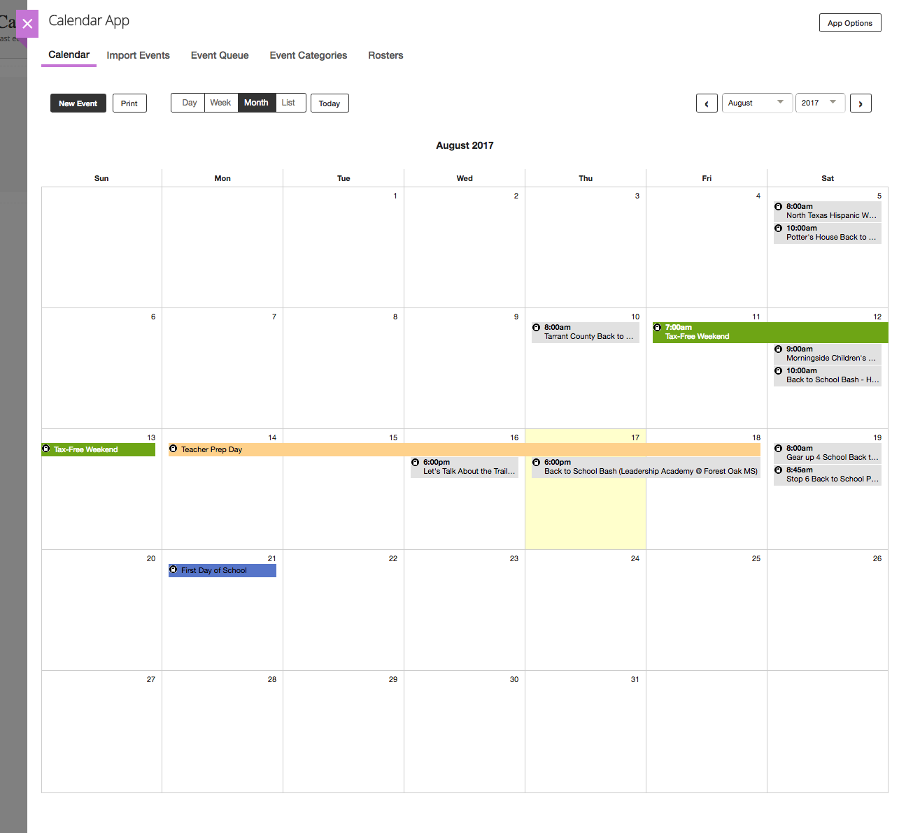
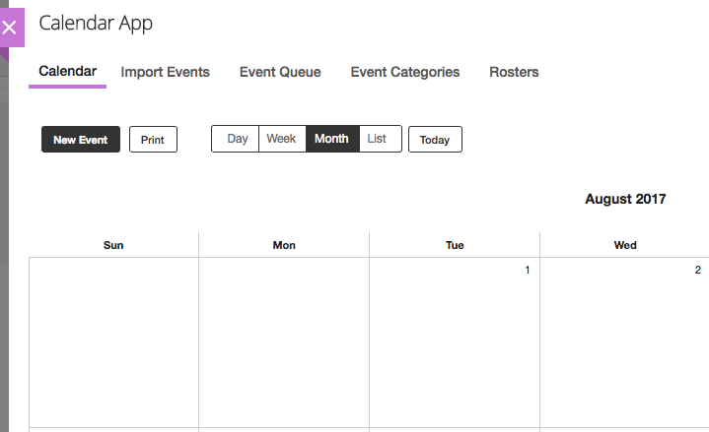
Current Pages
Calendar
In the Calendar App there are two ways to add an event: 1. Click “New Event” in the top left 2. Double-click the date you wish to edit or add your event to

Slide 10
Sites & Channels
On the left hand side of your Site Manager you will find the “Sites & Channels” area
Your site’s channels are listed below your campus name
The channels correspond with the menu items on your homepage

Slide 11
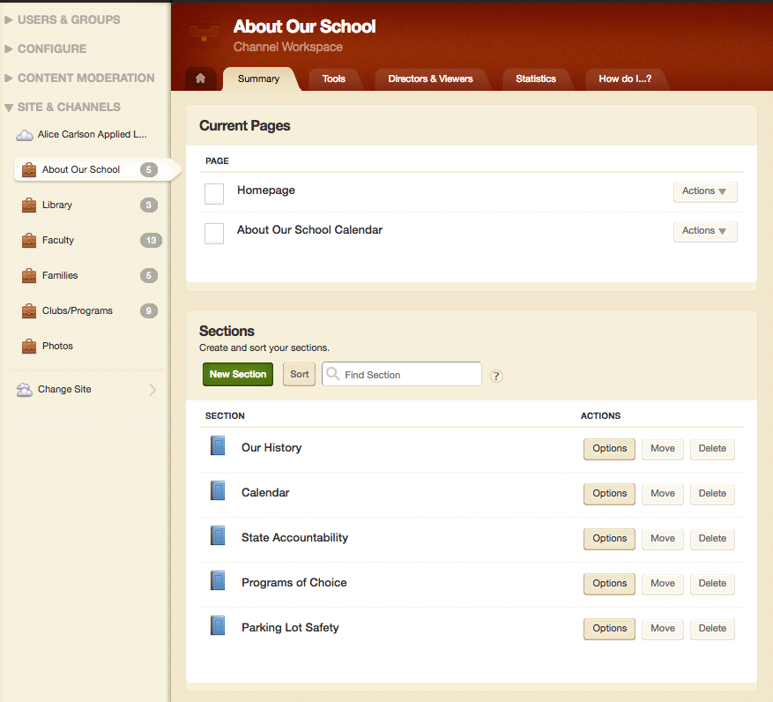
Sites & Channels
To edit/add content to any of the channels, simply click it and you can add, edit and organize apps the same way we covered earlier on the homepage
Each channel can have it’s own organizational sections. Sections can be added by clicking “New Section” in the middle of your selected channel page.

Slide 12
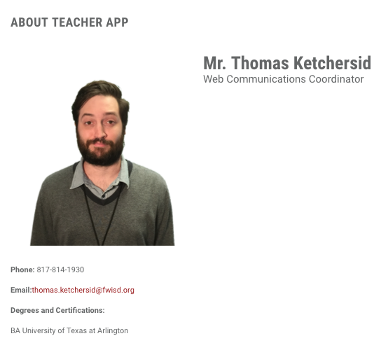
Apps, Pages and Additional Resources
www.fwisd.org/training
The site linked above provides additional training cards, videos and manuals
Examples of all all available apps and page types are available to give you an idea of what they will look like on the page so you can find exactly what you need
Email or call Thomas Ketchersid anytime
thomas.ketchersid@fwisd.org
817-814-1938

